Slide 1

ArcGIS Enterprise Overview John Fry Parker Hornstein

Slide 2
Agenda
Overview of ArcGIS Enterprise
Portal for ArcGIS
Story Maps
Web Application Templates

Slide 3
Overview
Notes:
What is ArcGIS Enterprise? How many of you actively use it? What is portal for ArcGIS?

Slide 4


ArcGIS Enterprise is a full-featured mapping, analytics and data management platform that runs on infrastructure you control, enabling you to visualize, interpret, and act upon your location-based data.

Slide 5


When we talk about Web GIS we are talking about an end-to-end experience – not just a REST service.
ArcGIS Enterprise
ArcGIS Online

Slide 6



ArcGIS Online
ArcGIS Pro
ArcGIS Apps
ArcGIS Enterprise
ArcGIS for Developers

Slide 7
Components of ArcGIS Enterprise
ArcGIS Server
Portal for ArcGIS
ArcGIS Data Store
ArcGIS
Web Adaptor
Relational
Tile Cache
Spatiotemporal

Slide 8
Server Licensing Roles
ArcGIS Server
GIS Server
GeoEvent Server*
Image Server
GeoAnalytics Server
One software component, multiple server roles
A role = functionality + service types
Role-based licensing allows you to dedicate hardware to server functionality

Slide 9
Patterns of Use and ArcGIS Enterprise
Mapping & Visualization
Data Management
Field Mobility
Monitoring
Analytics
Design & Planning
Decision Support
Constituent Engagement
Sharing & Collaboration

Slide 10
What is portal for ArcGIS

Slide 11
What is portal for ArcGIS

Slide 12
Demo Portal for ArcGIS

Slide 13
Story Maps: Enabling Location-Based Storytelling

Slide 14
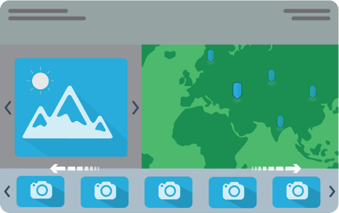
What are Story Maps?
Story Maps are web apps that combine interactive maps, multimedia content, and user experiences

Slide 15

What are Story Maps?
Story Maps include an array of apps that provide different ways of telling a story with maps.
Notes:
-Like a swiss army knife
-Many tools that’ll help you get the job done
-All right at your fingertips

Slide 16
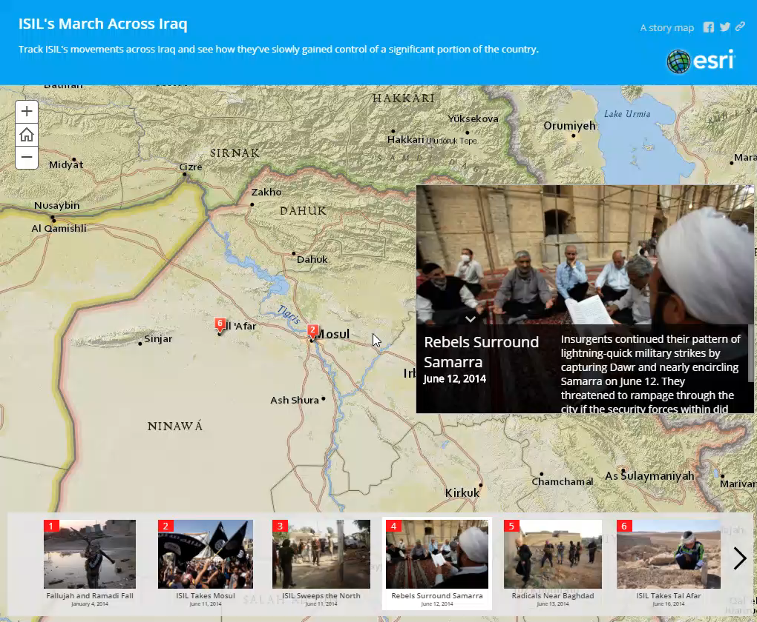
Interactive
Notes:
adds a tactile element to the presentation
Notice how there are a few ways to navigate around the story
map also remains active
Immerses user and allows for further exploration
-interactive map permits ad-hoc discussion with visual aid

Slide 17
Why Story Maps?
Story Maps are open source. You’re free to download them from GitHub and customize away.
GitHub Story Maps Repos
Notes:
We have repos set up for each story map template
You need developer skills in JavaScript, CSS, and HTML (Help is available, but some knowledge is required)

Slide 18
Types of Story Maps
Presenting a series of points of interest
Sequential narratives
Comparing two maps
Enabling a “crowd” to participate in a story
Comparing
several maps
Scrolling through maps and multimedia
Notes:
Apps designed for a specific function
What are you trying to highlight? What’s the goal? Think about this before selecting a template.

Slide 19











Types of Story Maps
Story Map Tour
Story Map Playlist
Story Map Swipe
Story Map Side Accordion
Sequential Narrative
List of Items
Comparing Two Maps
Comparing Related Maps
Story Map Journal
Story Map Countdown
Story Map Spyglass
Custom story maps
Journal-style narrative
Ranked List of Places
Comparing Two Maps
Custom projects
Story Map Basic
Story Map Shortlist
Story Map Tabbed
More to come!
Displaying a single map
Curated List of POIs
Comparing Related Maps

Slide 20
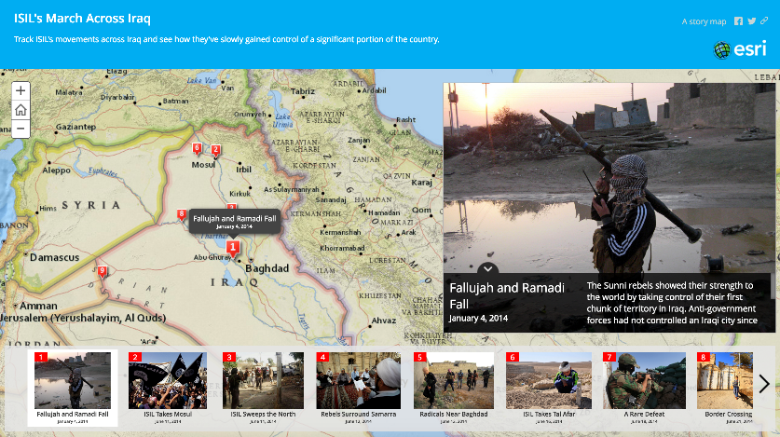
Map Tour: ISIL’s March Across Iraq
Link to Map Tour

Slide 21

Map Journal: Zika Virus: Past, Present, and Future
Link to Map Journal

Slide 22
Story Map Journal
Print Story Map

Slide 23
Demo Story Maps

Slide 24
Demo Web Application Templates

Slide 25
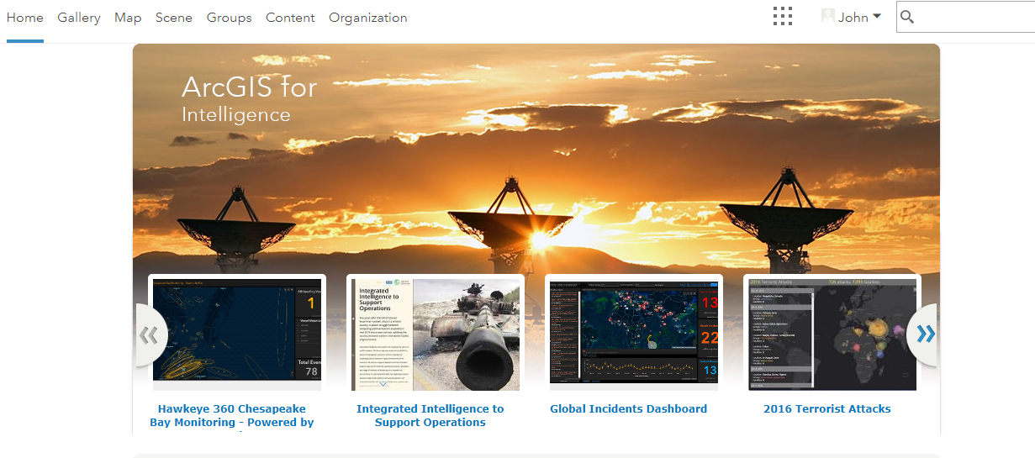

Slide 26
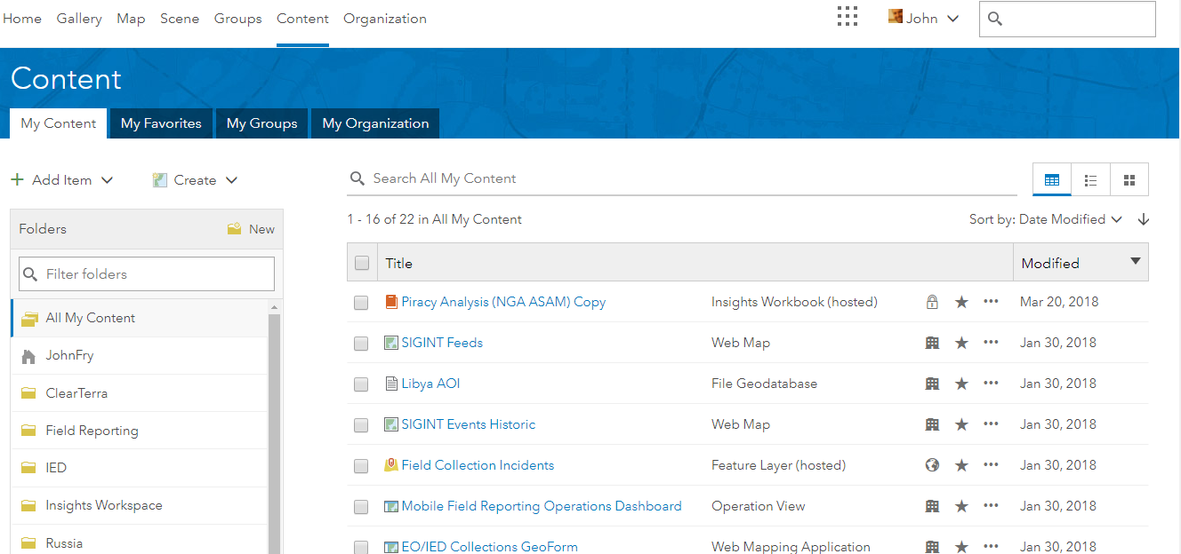

Slide 27
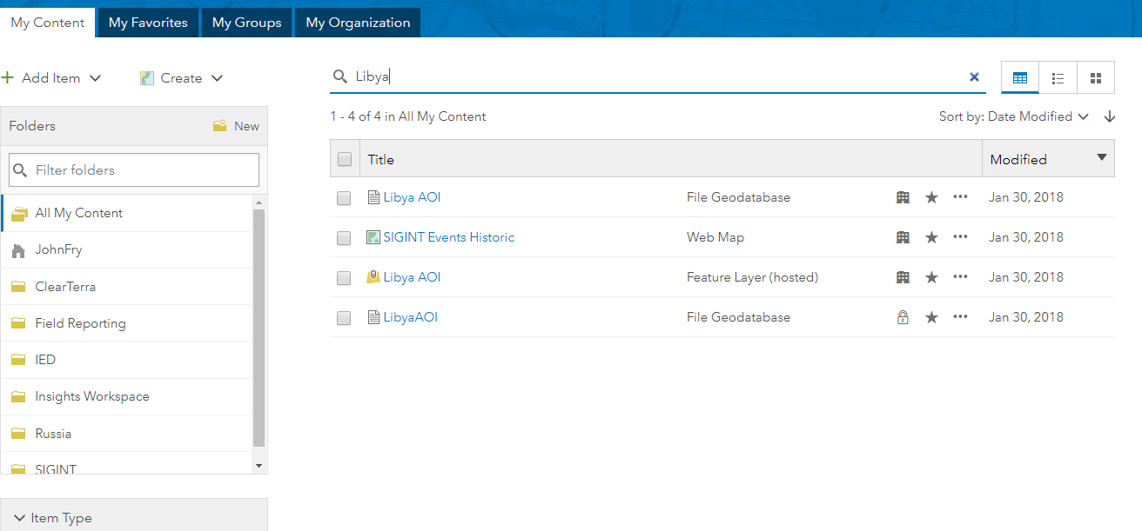

Slide 28
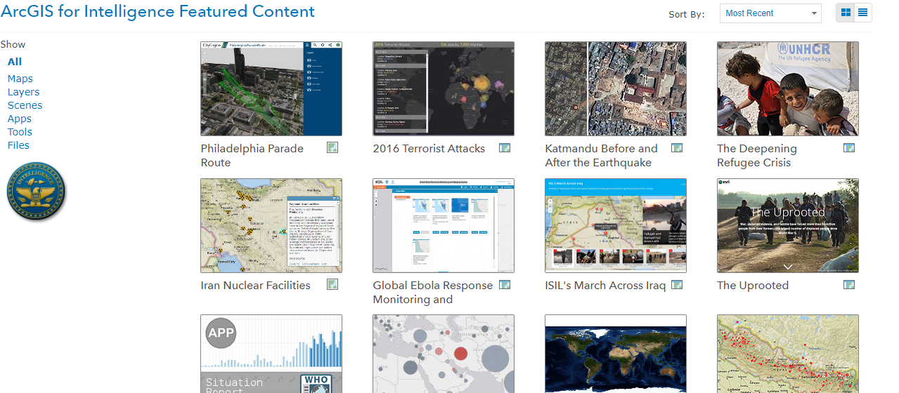

Slide 29
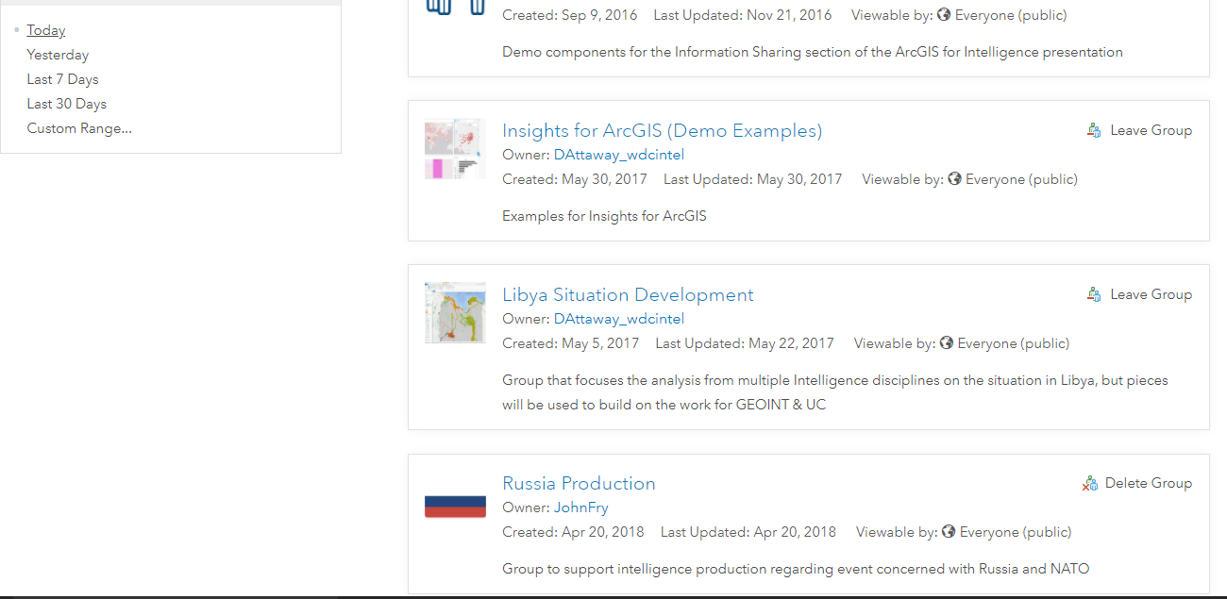

Slide 30
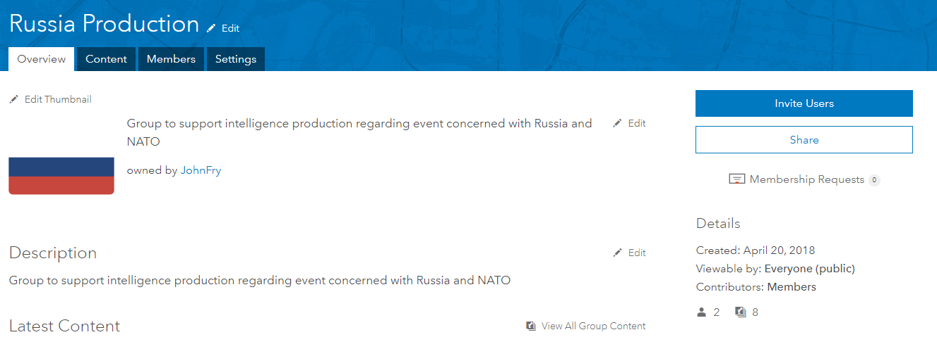

Slide 31
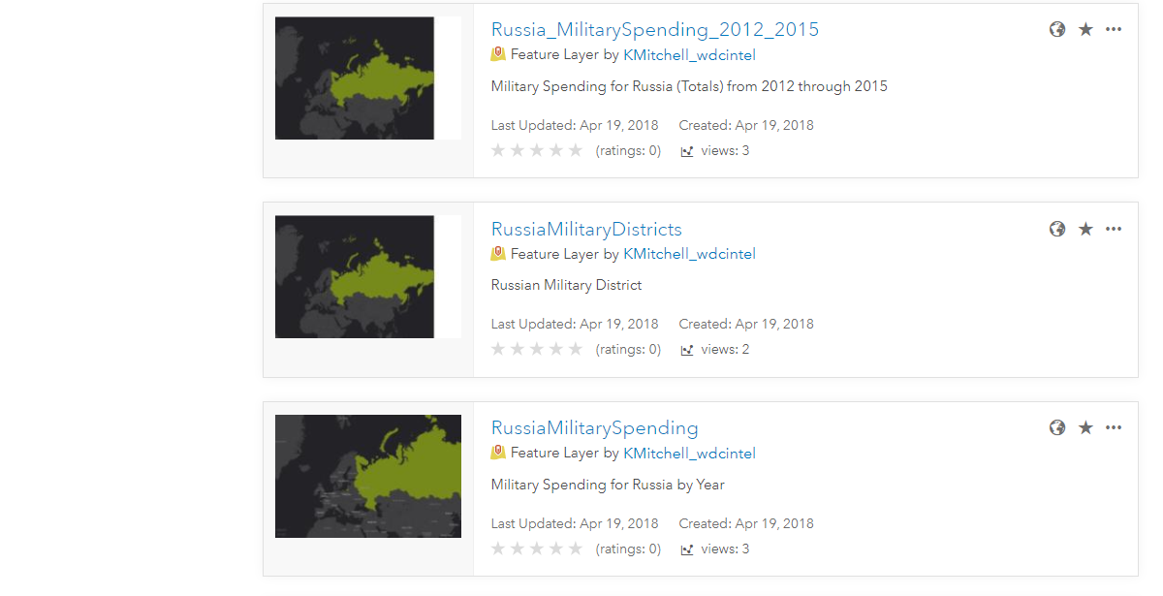

Slide 32
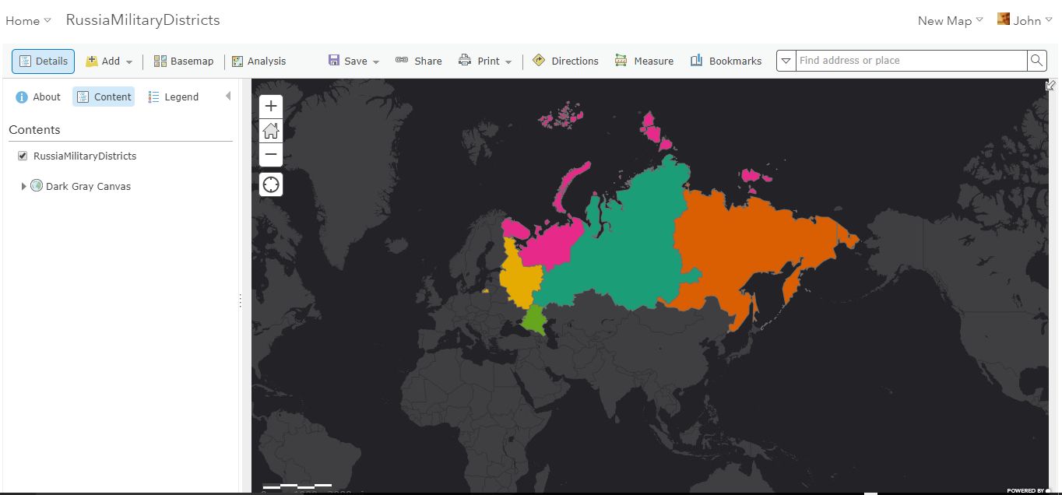
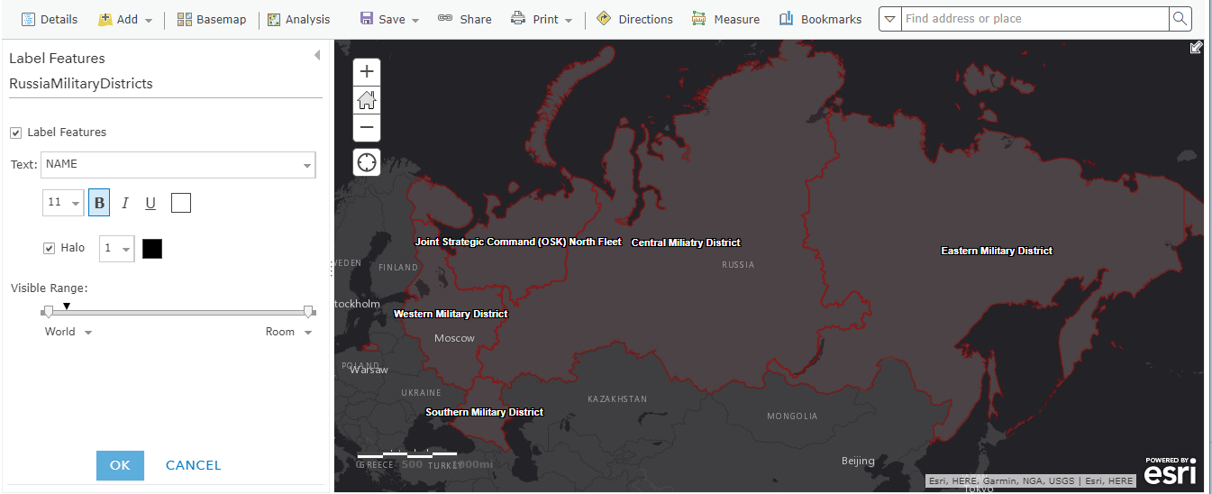

Slide 33
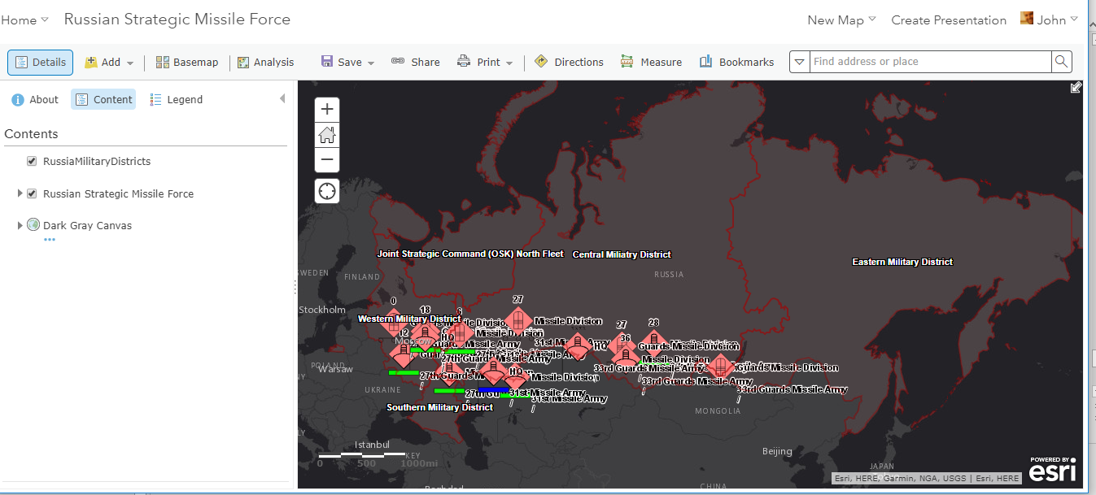

Slide 35
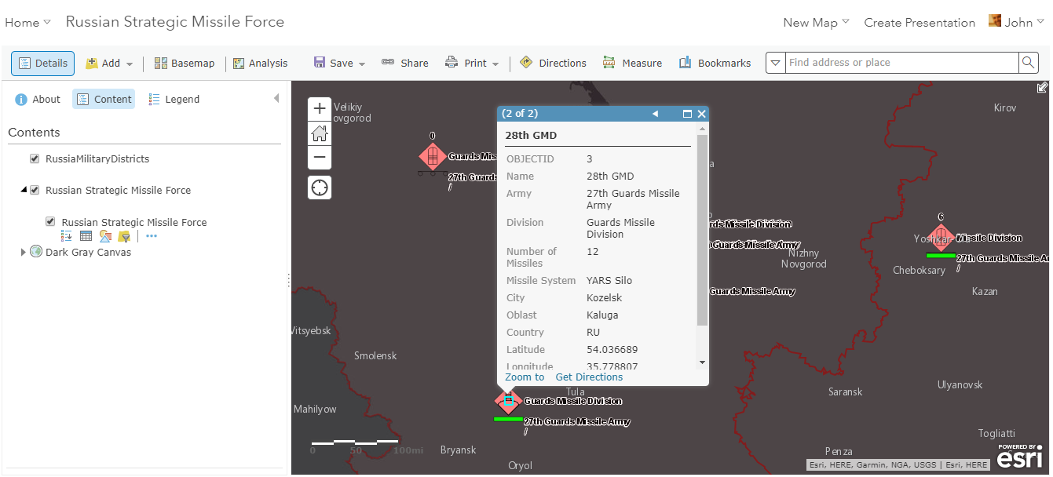

Slide 36
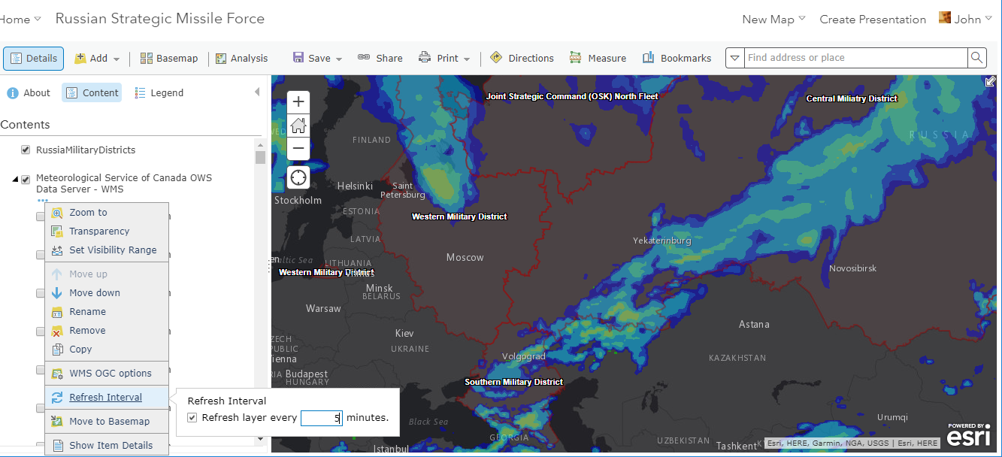

Slide 37
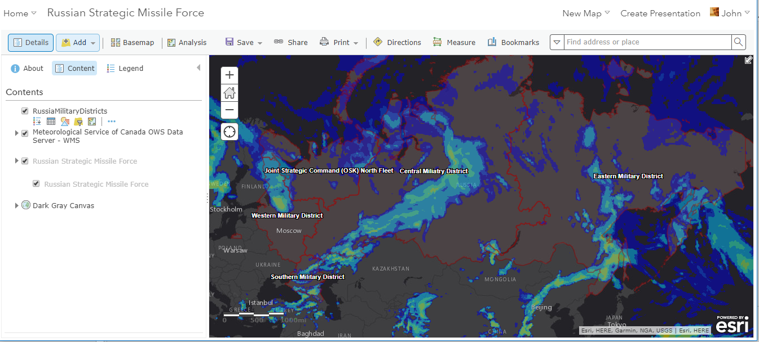

Slide 38


